Slide 1
IN-HOUSE NETFLOW/IPFIX
FLOW COLLECTION TESTING

Slide 2
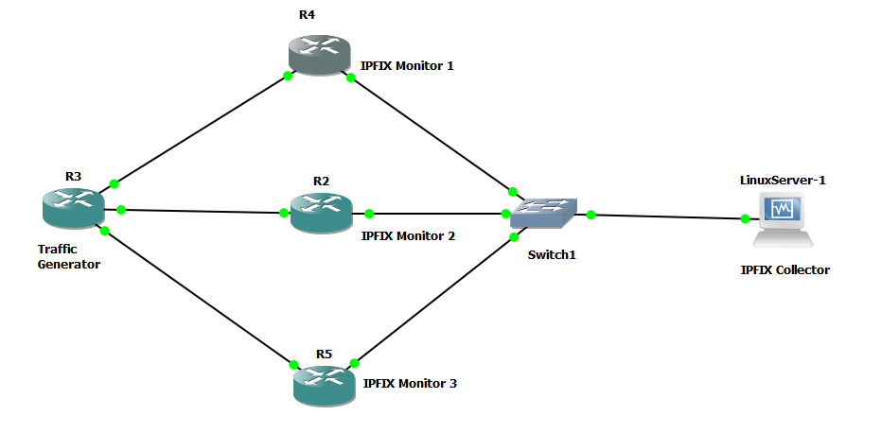
GNS3 Topology used for IPFIX Collector testing

Slide 3
Description of the topology
Device information
Cisco Router Series – C7200
Linux Ubuntu version – 16.04.6 LTS
The Linux server and the routers R2,R4 and R5 belong to the same LAN
OSPF routing protocol is configured on the routers. The linux server has a default route to R2
The Traffic generating router R3 generates a continuous rotational source ping from each of the interfaces connected to it. The destination is the linux server. The generation of the ping is automated by using a python script running in the linux server
The ingress and egress interface is monitored for IP traffic on the three routers R2,R4 and R5, on the interfaces connected to the switch

Slide 4
Testing of IPFIX Collector
If a particular flow is inactive for 15 sec the flow expires and it is exported to a flow collector and for active flow ,flow is exported after 30 minutes to the flow collector
The collector is used to collect flows. Here it is in the Linux server
The collectors stores the exported flows in a file in binary format.
The collector files are rotated for every n minutes. At the end of nth minute, the flows collected during those n minutes can be viewed using CLI command. The CLI command can be fired using a python script and the flows read from the file can be dumped into a MySQL database
The testing has been done and the flows collected in the collector is getting dumped into mysql database

Slide 5
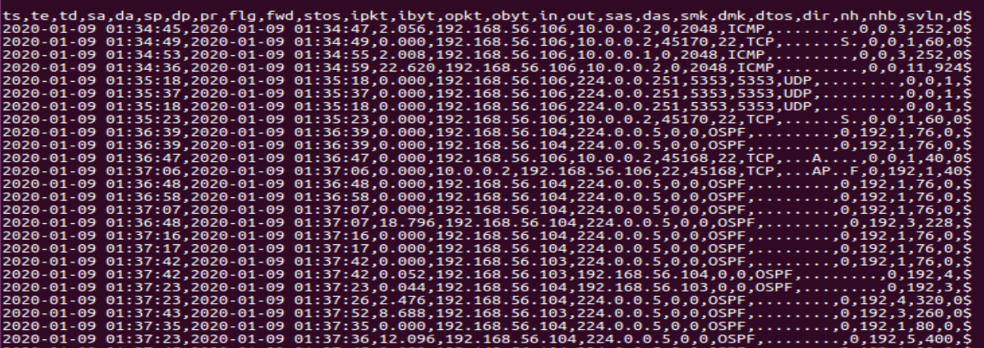
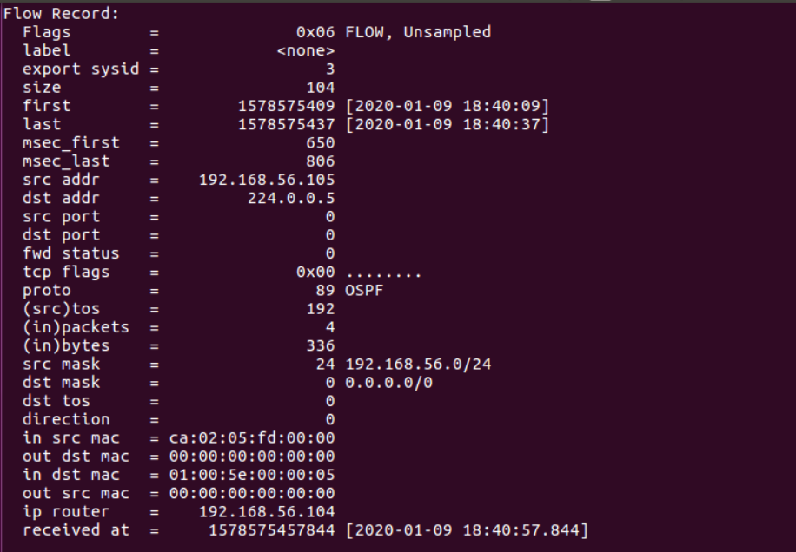
Screenshot of the collector file :
Screenshot of the raw output after firing CLI command

Slide 6
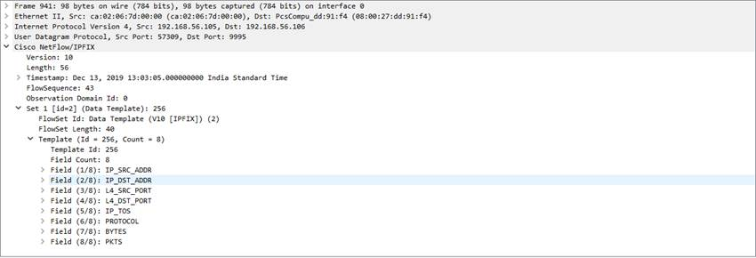

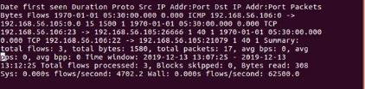
Screenshots from WireShark and Routers

